Slide 1
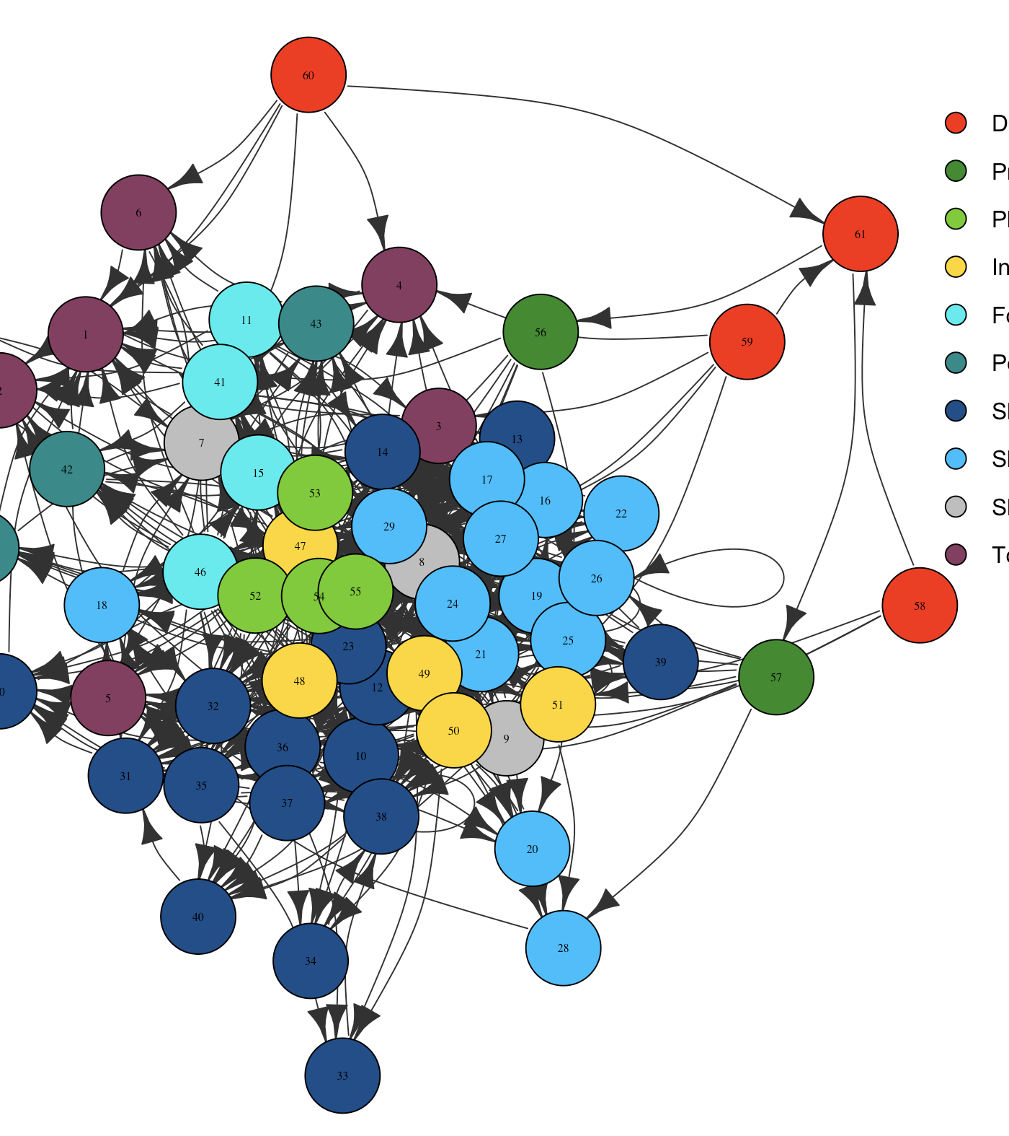
Atlantis Example Implementation
Beth Fulton | 2021
Notes:
<number>

Slide 2
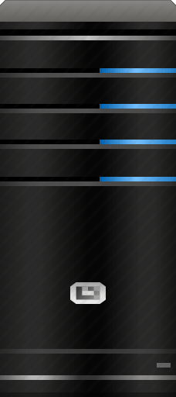
Acknowledgements
CSIRO (modelling and beyond)
Tony Smith Bec Gorton Penny Johnson David Smith Marie Savina Jeff Dunn Donna Hayes Rudy Kloser | Cathy Bulman Brian Hatfield Francis Pantus Heidi Pethybridge Javier Porobic Trevor Hutton
Notes:
<number>

Slide 3
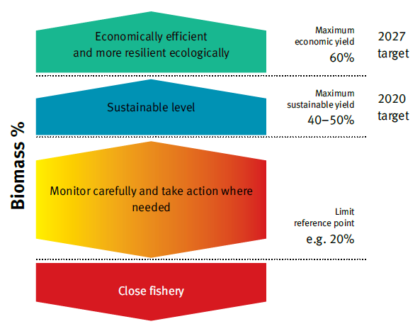
Fisheries Management Guidance
Strategic insights
synthesise information
identify key processes
simulate possible ecosystem responses (e.g. climate change)
check reliability of management options
set management reference points
Notes:
<number>

Slide 4



Australian Examples: SESSF
Multi-everything fishery
Highly diverse and variable
Solutions needed
Notes:
In 2005, Australia's commercial fisheries were struggling with economic and environmental sustainability. An assessment of stocks in Commonwealth fisheries showed that 29 per cent of commercial species were overfished or vulnerable to overfishing.
As a result the Australian Fisheries Management Authority (AFMA) was directed to take immediate action to cease overfishing and recover overfished stocks to levels that would ensure long term sustainability and productivity.
AFMA was also ordered to take steps to avoid further species from becoming overfished in the short and long term, and to manage the broader environmental impacts of fishing, including on threatened species.
A Commonwealth Harvest Strategy Policy (HSP) was needed to ensure the recovery of fish stocks and return the fisheries to sustainable profitability.
<number>

Slide 5
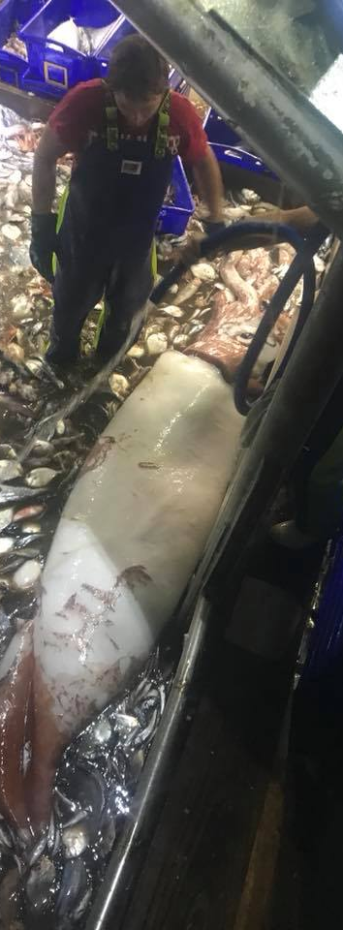
Alternative Management Strategies
Rethink management arrangements for SESSF
Strategic approach – bring stakeholders along
Two phases
qualitative (expert judgement)
quantitative (Atlantis model)
Notes:
<number>

Slide 6

Scenarios
9 variants, but 4 main options
Status quo (quota management & not that effective)
Quotas on everything of value
Integrated management (zoning; gear restrictions; quotas)
Conservation driven (open paddocks, closed world)
Notes:
<number>

Slide 7
Expert considerations
Each concentrate on focus topic
Stock assessments, economics
Assumed linear relations
Miss interactions
Miss dynamic human behaviour
Gross Value Product
Fish Size
Notes:
Modelos cualitativos. Cuando todo se pone en conjunto salen ala vista interacciones que son importantes
<number>

Slide 8

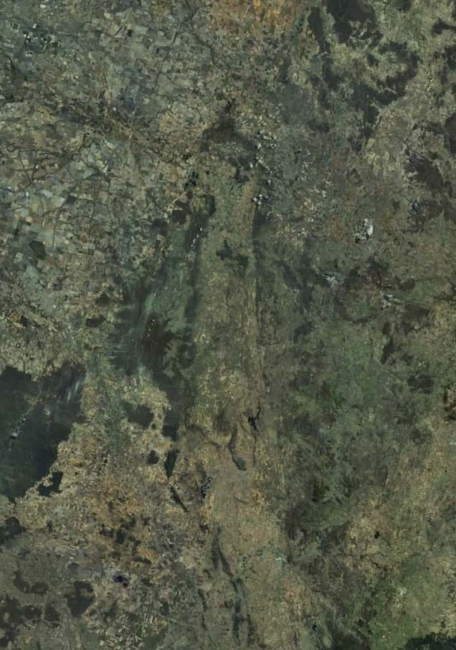


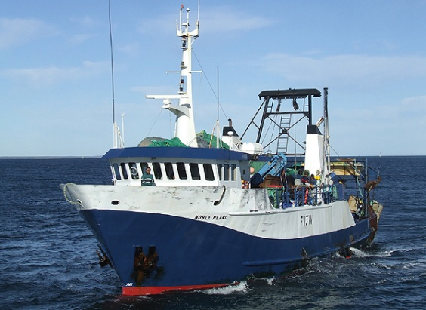
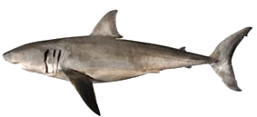
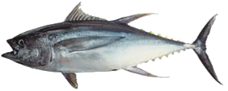

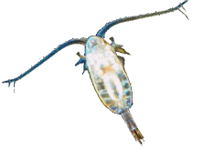
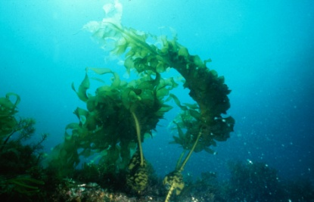
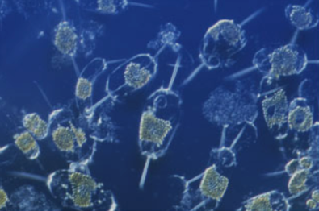
SE Australia model content
MANAGEMENT
SOCIOECONOMIC
INDUSTRIES
PREDATORS
FOOD WEB
PLANKTON
HABITAT
ENVIRONMENT
Notes:
La zona esta ubicada en el area Sur Este de Australia, incluyendo tasmania
Donde operan todas las pesquerias que son importnates para el SESSF
<number>

Slide 9
Geometry
Notes:
Este modelo tiene 63 cajas
7 capas de profundidas
- la divicion de las cajas se baso en:
1) bioregionalizacion
2) componentes fisicos
3) componens antropogenico
1) Donde tenemos mayor numero de otras industrias (afluentes de los rios)
2 puertos pesqueros y de desembarque
3 areas de pesca historicas
<number>

Slide 10
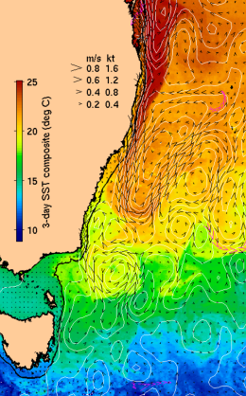
SE Australia model content
MANAGEMENT
SOCIOECONOMIC
INDUSTRIES
PREDATORS
FOOD WEB
PLANKTON
HABITAT
ENVIRONMENT
Notes:
Modelo hidrodinamico llamado BlueLink que es uno de los tantos modelos hidrodinamicos que tienen aca en Australia
El area que ocuparon del modelo es el area que solamente oncluhe el SESSF
- Principales corrientes
- cambio en las mareas
<number>

Slide 11
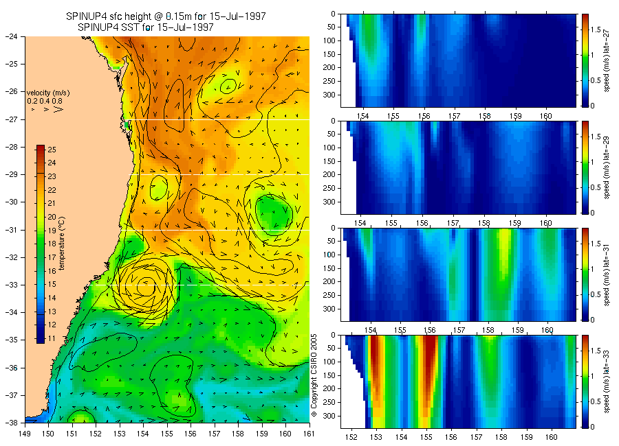
Hydrodynamics
OFAM (ROMS-like) + GCM
Notes:
Ocean Forecasting Australia model + Gglobal climate model
- Used for projections
- estructuras de mesoescala
- temperatura, salinidad,y corrientes
<number>

Slide 12

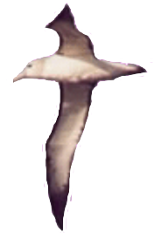
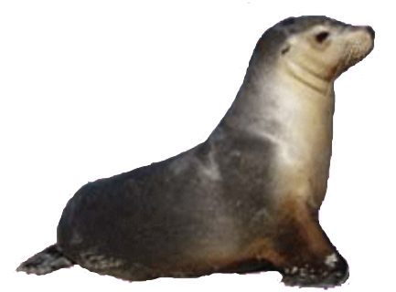
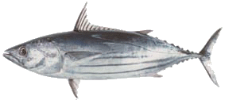


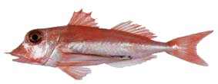

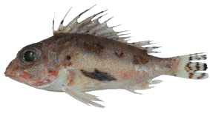
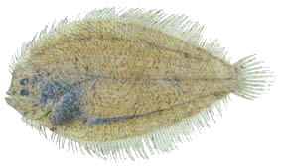
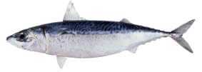
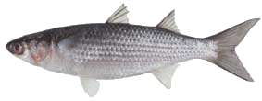
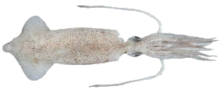
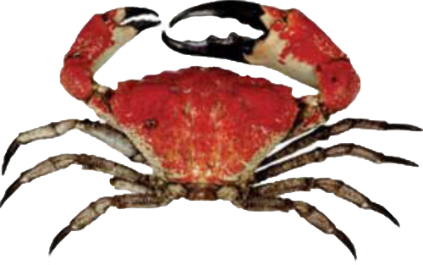
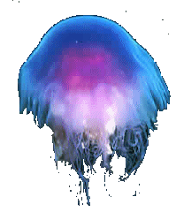
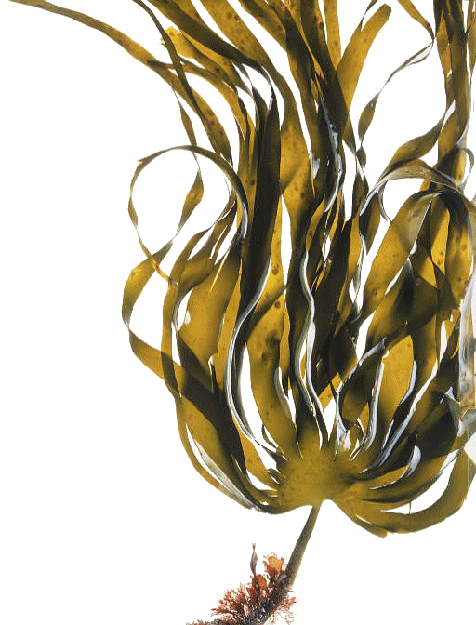

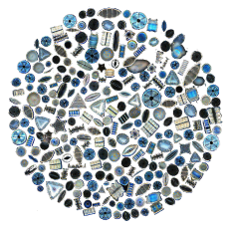
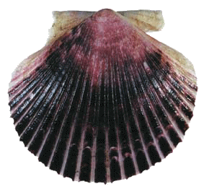
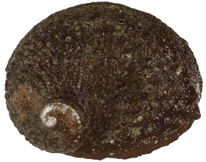
SE Australia model content
MANAGEMENT
SOCIOECONOMIC
INDUSTRIES
PREDATORS
FOOD WEB
PLANKTON
HABITAT
ENVIRONMENT
Notes:
Cadenas troficas completas
- Desde bacterias, productores primarios a especies objetivos de las pesquerias
- predadores topes y especies carismaticas
- especies bentonicas
<number>

Slide 13
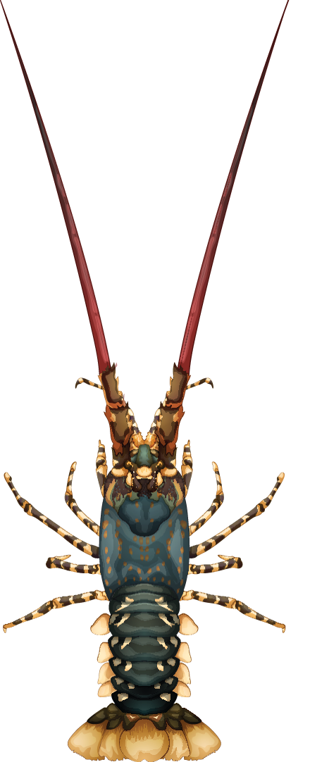
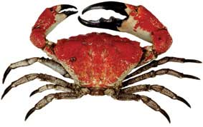
Modelled groups - Invertebrates
21 biomass pools 2 phytoplankton 3 zooplankton Jellies Squid Bacteria (pelagic, demersal) Meiobenthos Infauna Deposit feeders | Filter feeders Scallops Grazers Megazoobenthos Lobsters Giant crab Prawns Seagrass Macroalgae
Harvested
Conservation concern
Notes:
21 grupos que son conglomerados de biomasa2 grupos de fitoplancton 3 zooplancton
En su version mas avanzada este modelo cuenta con varios grupos de cefalopodos
Pasto marino and Macroalga estan desaparciendo en Tasmania y han afectado negativamente la biodiversidad, y la produccion pesquera
<number>

Slide 14
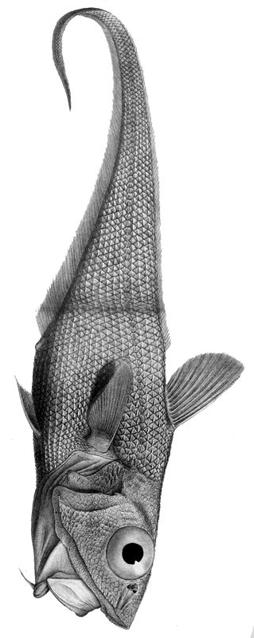

Modelled groups - Vertebrates
32 age structured Small pelagics Red bait Mackerel Migratory mesopelagics Non-migratory mesopelagics School whiting Shallow water piscivores Blue warehou Spotted warehou Tuna and billfish Gemfish | Shallow water demersal fish Flathead Redfish Morwong Ling Blue grenadier Blue-eye trevalla Ribaldo Orange roughy Dories and oreos Cardinalfish Gummy shark School shark | Demersal sharks Pelagic sharks Dogfish Gulper sharks Skates and rays Seabirds Seals Sea lion Dolphins Orcas Baleen whales
Harvested
Conservation concern
Multiple genetic stocks
Notes:
<number>

Slide 15
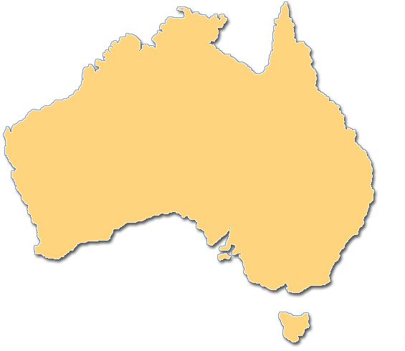
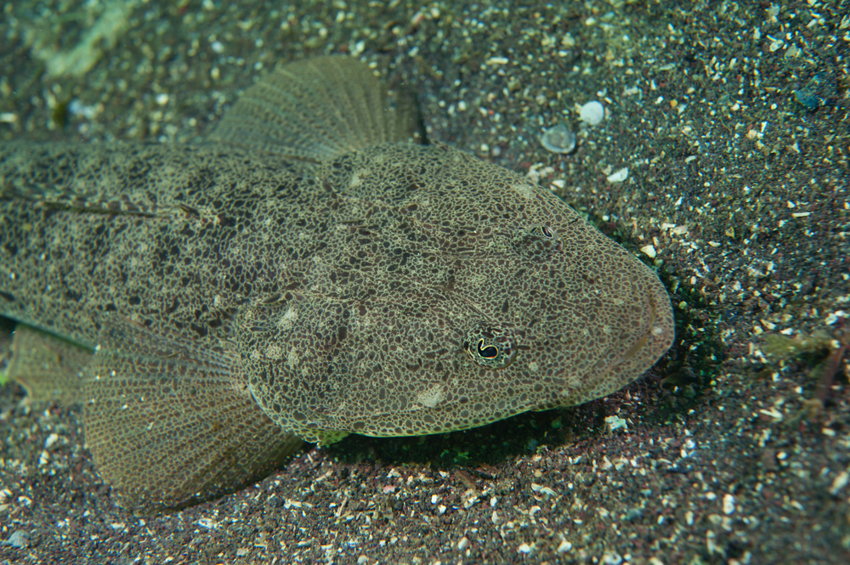
Modelled groups - Stocks
Assumed stock structure = as for assessments
Multiple size-at-age possible
realised diet
phenotypic variation
Notes:
Los estock usados en el modelo son similares a los usados durante la evaluaciones de stock.
Han sido reforzados con dieta observada
Phenotipic variation
<number>

Slide 16
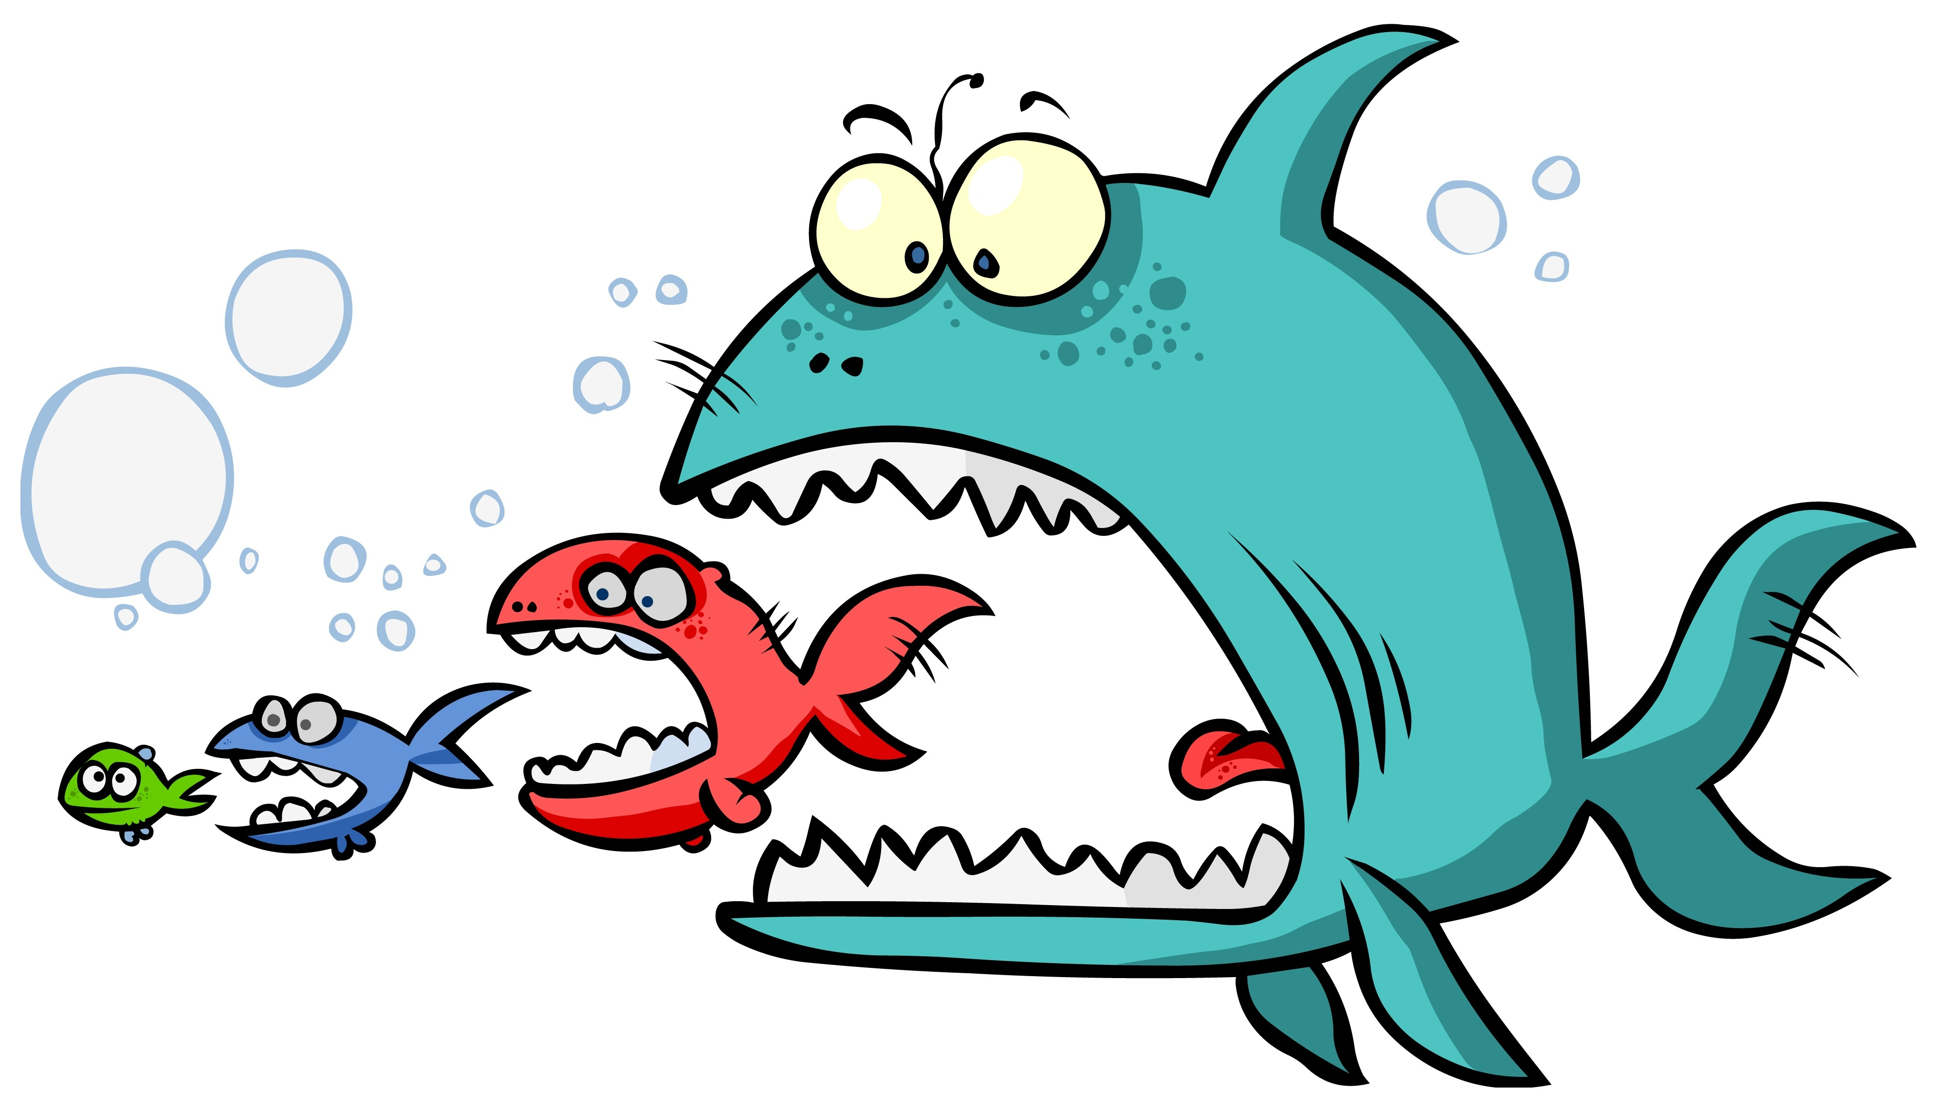
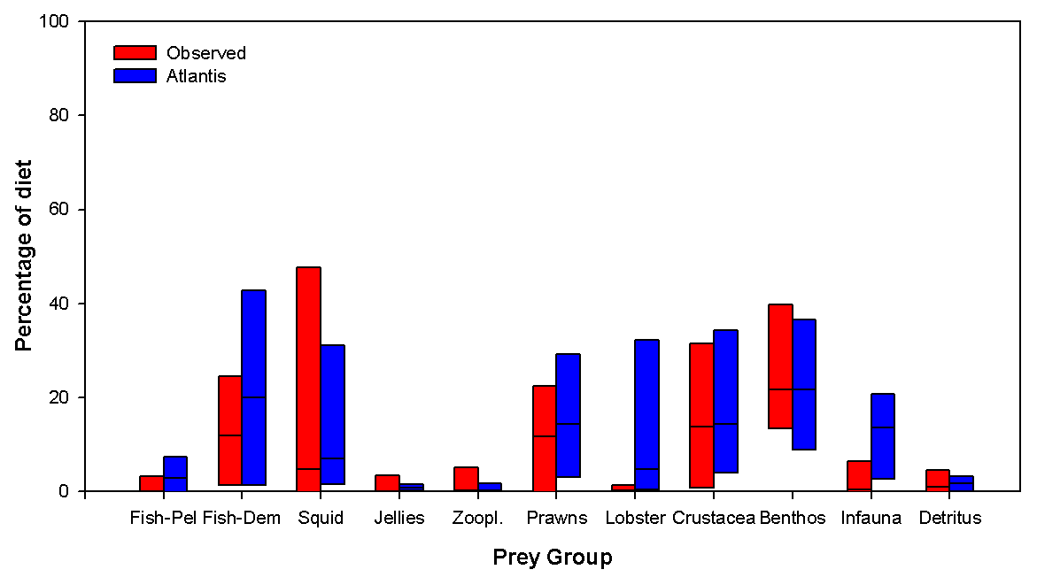
Model performance
Ontogenetic shifts
Flexible in space and time
Notes:
<number>

Slide 17
Model performance
General agreement with assessments
Notes:
Algunos ejemplos
Ambos sistemas de modelacion dan resultados similares en terminos de biomassa relativo.
<number>

Slide 18

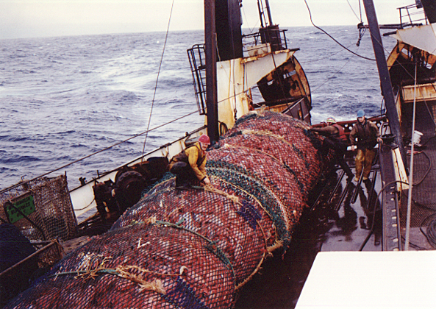
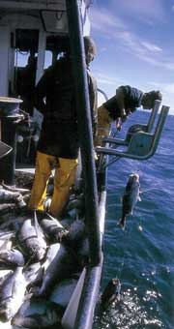


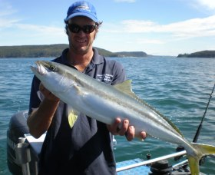
SE Australia model content
MANAGEMENT
SOCIOECONOMIC
INDUSTRIES
PREDATORS
FOOD WEB
PLANKTON
HABITAT
Métiers = gear, species, port, vessel size & behaviour
Different markets, trip length & steaming vs fishing
ENVIRONMENT
Notes:
Atlatnis usa el concepto de metier.
Donde la agrupacion se hace incluyendo no solo el arte de pesca, sino que todo lo asociado con la faena de pesca, incluyendo comportamiento
<number>

Slide 19
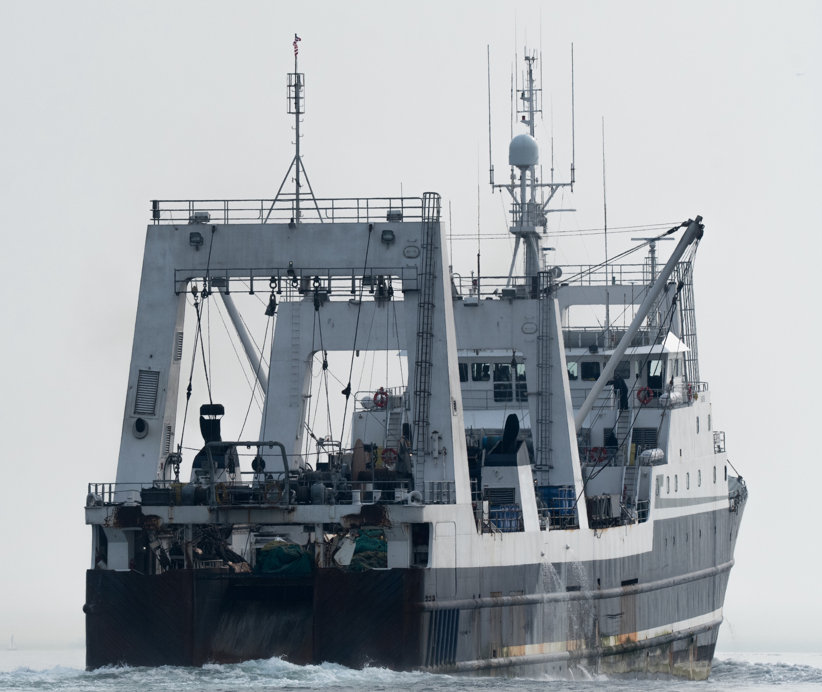
Modelled fisheries
32 métiers Dive Fin-fish auto-longline Fin-fish drop line Fin-fish mesh net Fin-fish trap Inshore line Pots Recreational | Scallop dredge Shark net Shark longline Small pelagic purse seine (States and Commonwealth split) Squid jig Tuna longline Tuna purse seine Shelf demersal trawl (States, SET, GABT split) Cephalopod trawl Crustacean trawl | Prawn trawl Fin-fish midwater trawl Squid midwater trawl Danish seine General demersal (slope) trawl Shelf demersal trawl Orange roughy trawl
Simple demand & CPUE based
Socioeconomically driven
Notes:
En estock assessment actualmente usan 17 metiers
Si se hace un analysis de conglomerados donde se agrupan casa accion de pesca se obtienen 31
Algo similar a lo usado por Atlantis
<number>

Slide 20
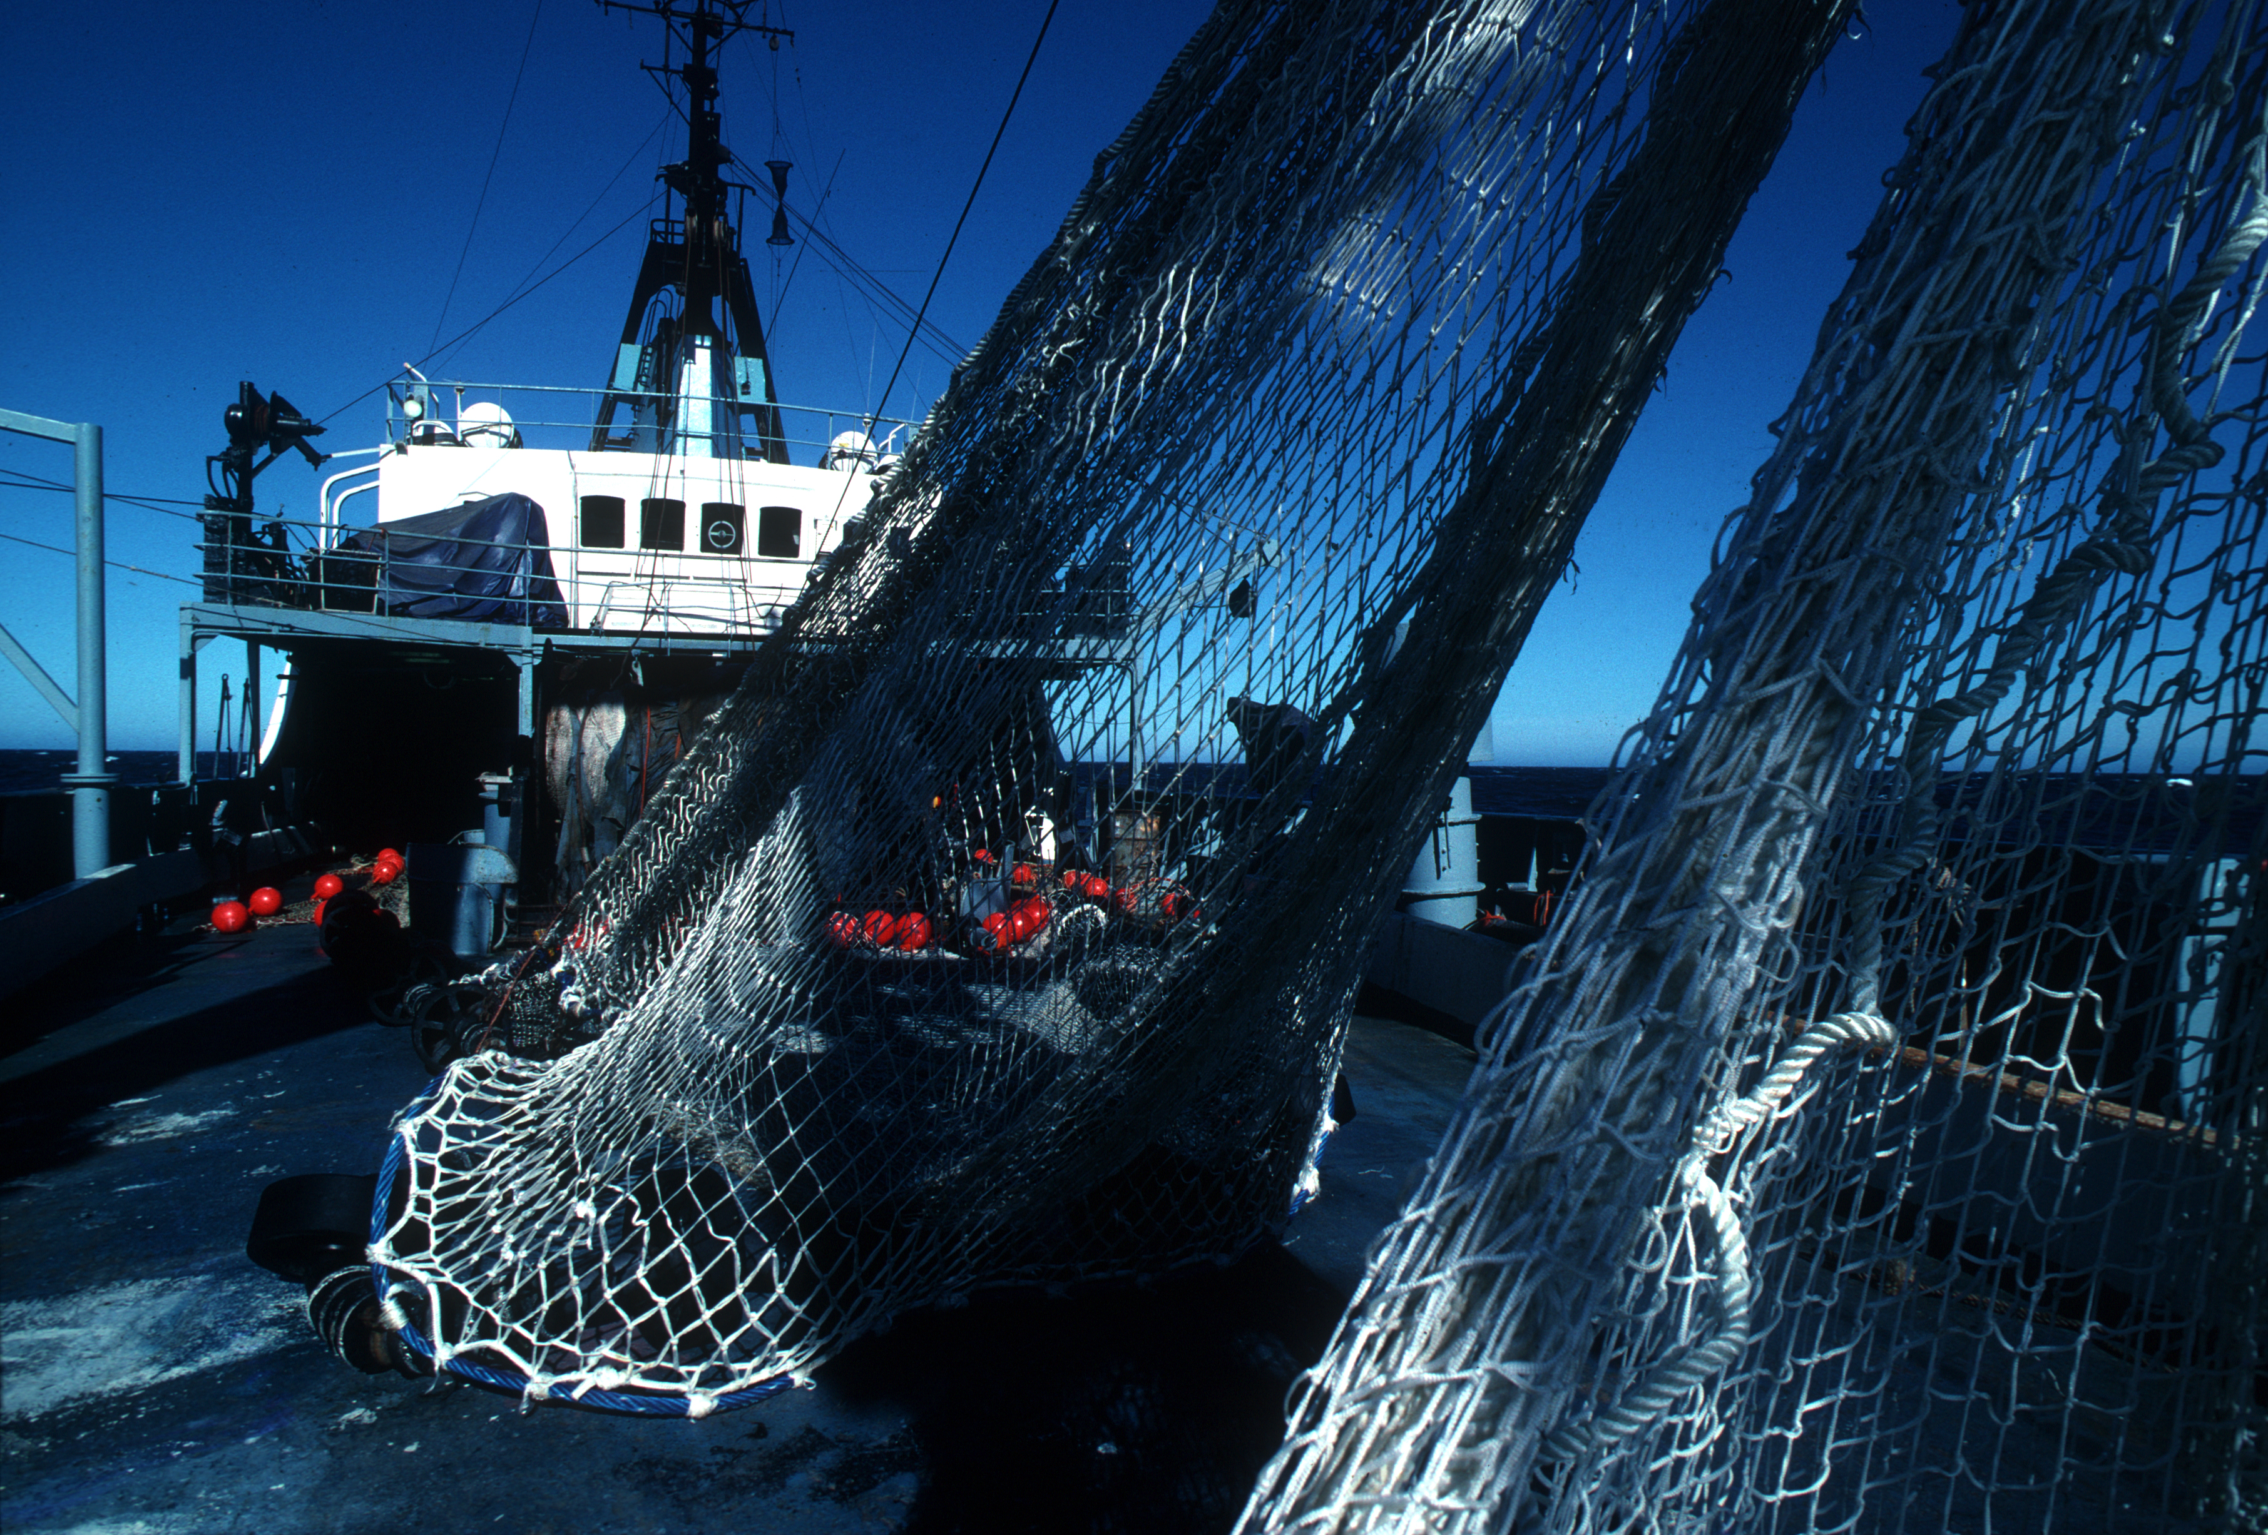
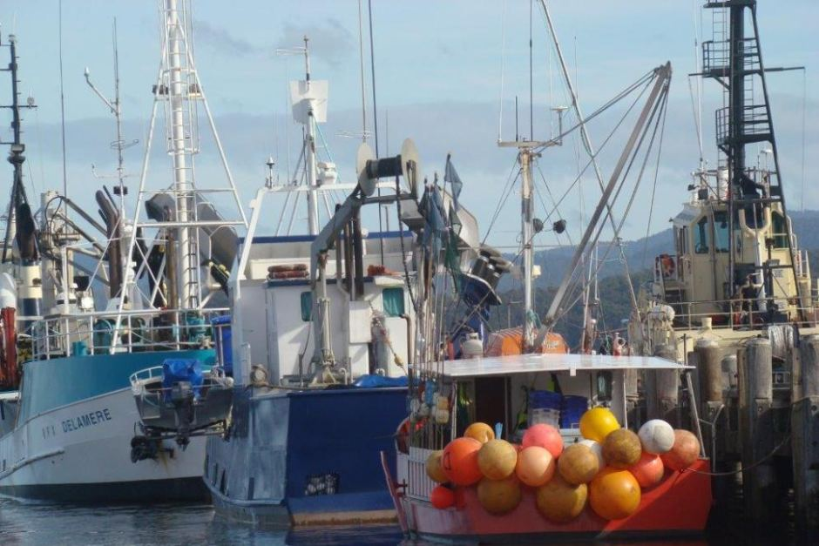
Fisheries details
State fisheries = static background pressure
SESSF fisheries = dynamic
target species
gears
ports
vessel sizes
quota trading
shifting targeting
Notes:
Aguas jurisdiccionales de cada estado, donde la pesca es controlado por ese estado en particular
<number>

Slide 21
Model performance
Training and test set
general trends ok
individual humans = HARD to predict, but aggregate behaviour predictable
Notes:
<number>

Slide 22
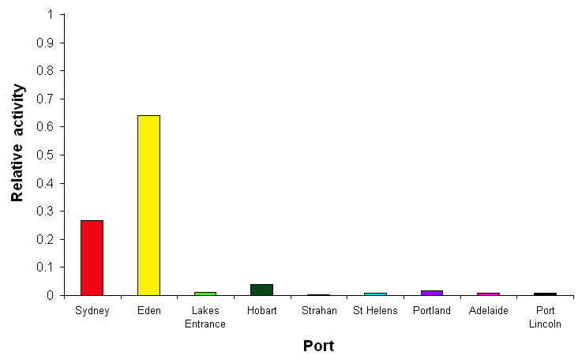
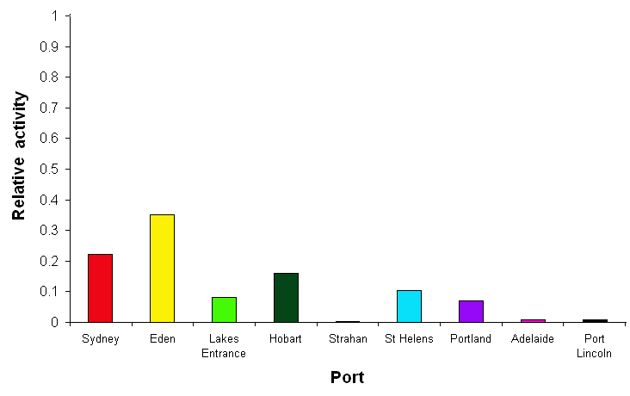
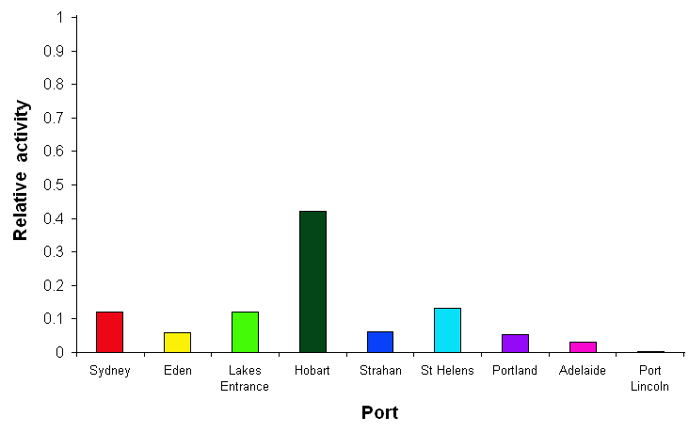
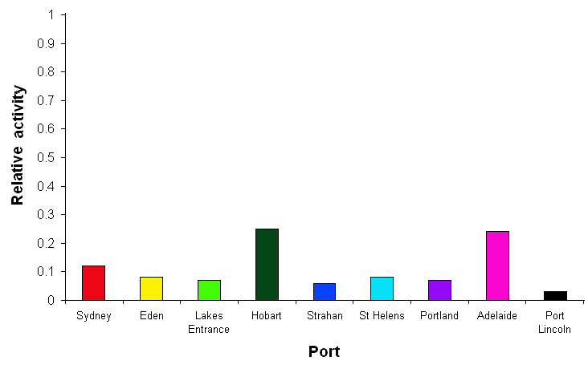
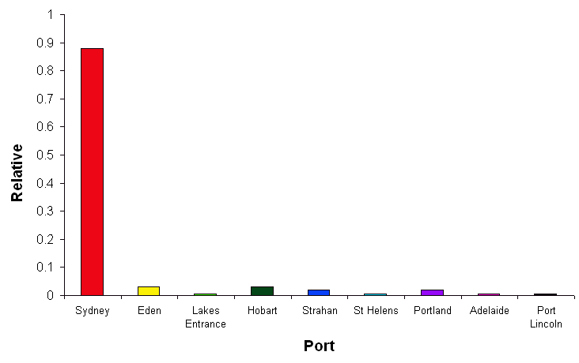
Model performance
Reproduced Secondary characteristics
e.g. port activity levels
Notes:
Por ejemplo de pendiendo de que tan lejos estan realizando la faena de pesca, los metier pueden descargar su pesca en differente puertos y estos cambian constantemente
<number>

Slide 23
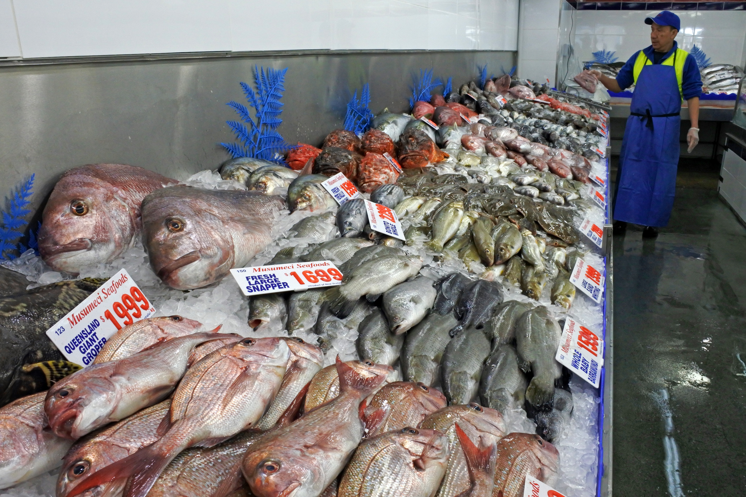
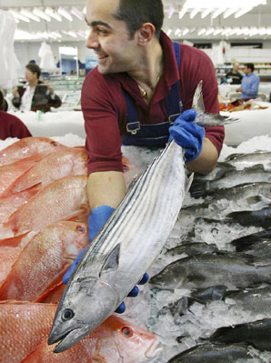
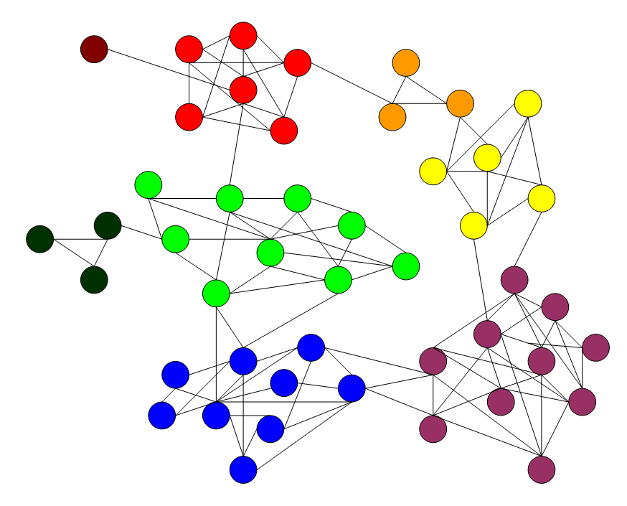
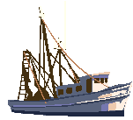



SE Australia model content
MANAGEMENT
SOCIOECONOMIC
INDUSTRIES
PREDATORS
FOOD WEB
PLANKTON
HABITAT
ENVIRONMENT
Notes:
It is also important to represent the social and economic pressures that dictate the decisions made by operators in those systems - and the dynamics of human behaviour (because economics just doesn’t cut it)
<number>

Slide 24






SE Australia model content
MANAGEMENT
SOCIOECONOMIC
INDUSTRIES
PREDATORS
FOOD WEB
PLANKTON
HABITAT
ENVIRONMENT
Notes:
Lastly we close the representation of the adaptive management cycle by including the management methods and decision making process.
This does cover a lot – but that’s because important processes for marine ecosystems cover 14 orders of magnitude in space and time from microbial scales to ocean basins. More importantly even management deals directly with scales from 10s metres to 1000s kms.
<number>

Slide 25








Data Flow
m
m
Notes:
2 different attlantis model
<number>

Slide 26

Output considered
Spatially and in aggregate:
catch composition
catch distribution
effort distribution
Notes:
<number>

Slide 27



Output considered
Notes:
Ajuste a dat aobservada y para mostrarles el tipo de resultados que se pueden obtener
Y veremos los escenarios mas especificos
<number>

Slide 28

Scenario outcomes
Status quo (2006)
Qualitative analysis
pessimistic
optimistic
Quantitative analysis
Notes:
Projecciones usando Atlantis y modelos qualitativos
- La industria no va bien
- eficiencia de manejo no tan buena como se pensaba
<number>

Slide 29

Scenario outcomes
Lots of quotas
Qualitative analysis
Quantitative analysis
Notes:
Not so good on the ecology and industry
Baste poco seguro
Altamente efectivo en terminos de eficienca del manejo
<number>

Slide 30

Scenario outcomes
Conservation
Qualitative analysis
Quantitative analysis
Notes:
El escenario de concervacion
- en la parte ecologica esta muy bien
- en la parte de socio-economica se ve affectada.
No existe un buen recivimiento desde las sociedad
<number>

Slide 31

Scenario outcomes
Integrated
Qualitative analysis
Quantitative analysis
Notes:
Manejo integrado
- diferentes tipos de assessment
- diferente fuentes de informacion
- diferentes reglas de manejo
- el resultado general no es perfecto pero es mucho mas positivo que los anteriores
<number>

Slide 32








Findings with Disciplinary Focus
Fishery
Industry statistics
Stocks
Decision rules
Best management = quotas (mostly)
Notes:
<number>

Slide 33




Findings with Cross-Disciplinary Focus
Fishery
Industry statistics
Stocks
Monitoring
Lobby groups
Decision rules
Best management = quotas + spatial + gear restrictions
Similarly for coastal zone management
Notes:
Cuando se incluyen mas actores y se permiten un manejo mas integrado (al menos para el caso de australia) el resultado es mejor.
El mejor manejo parace ser el que no solo incluye las cuotas sino el que ocupa componentes espaciales MPA y restricciones de GEARS
<number>

Slide 34


Major trade-offs exist
Conservation and economics
Short term costs vs long term pay-off
There were management costs (race to fish under lax management has its own costs – economic collapse)
While move to integrated management costly in short term it increased profit and reduced risk
Notes:
Concervacion y economia son dos objetivos que deseables pero que son dificilies de equilibrar
- Existe un costo en terminos de que tipo de manejo se hace.
- In manejo integrado es costoso en el corto plazo, pero produce incrementa las ganacia y reduce el riesgo en el futuro
<number>

Slide 35

Issues Tackled
EBFM and management strategy implications
unfished reference areas needed
spatial management = effective if chunky
no single solution (integrated better)
behavioural uncertainty is VERY important
strong trade-offs
goal state and acceptable impacts must be defined
Notes:
<number>

Slide 36

Outcomes
Contributed information to AFMA decision making
Fishery restructured
“Blue skies” integrated management is largely now how the fishery is managed
Decade later MSE testing ideas in ecosystem models = standard practice
Notes:
<number>

Slide 37
Projection Validation
Got effort pretty right
Foresaw mixed ability to recover, fulfill quota
Notes:
<number>

Slide 38

Thank you
CSIRO Javier Porobic
csiro.au
Notes:
<number>

