Slide 1
Monitoring and Assessments
Wealth from Oceans Flagship
Beth Fulton

Slide 2
Performance and Targets
Reference point management
  climate change shifting the goal posts
Relative value
Time

Slide 3

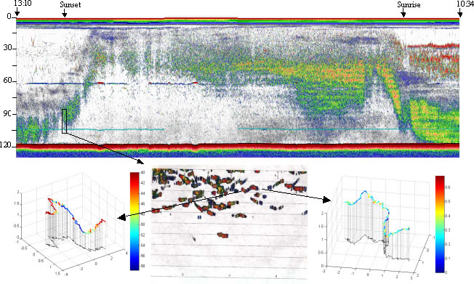
Reporting/Monitoring
Industry dependent reporting
  observers (can modify behaviour)
Fisheries independent data possible
  show costs and benefits of monitoring
Notes:
Observation model includes fisheries records + option for independent surveys
Replicates data patchiness/error/design problems
Assessment models = range of ones typically used from simple trend analysis to highly sophisticated (complicated) assessment methods
- Also includes the calculation of ecological indicators (if want to think about what real EBFM might entail)

Slide 4
Monitoring - Errors
Multiple scales and patchiness
Errors
  uniform, normal, lognormal
  multiple scales and patchiness
  variance
  bias
ACTUAL
Sampling distribution
Notes:
Observation model includes fisheries records + option for independent surveys
Replicates data patchiness/error/design problems
Assessment models = range of ones typically used from simple trend analysis to highly sophisticated (complicated) assessment methods
- Also includes the calculation of ecological indicators (if want to think about what real EBFM might entail)

Slide 5
Monitoring - Errors
Truth
Prediction
Predictive error
Observational uncertainty
Observational error
Observation
Residuals
Predictive Uncertainty
Notes:
Observation model includes fisheries records + option for independent surveys
Replicates data patchiness/error/design problems
Assessment models = range of ones typically used from simple trend analysis to highly sophisticated (complicated) assessment methods
- Also includes the calculation of ecological indicators (if want to think about what real EBFM might entail)

Slide 6
Monitoring - Errors
Truth
Residuals
Observational uncertainty
Prediction
Observational error
Observation
Residuals
Predictive Uncertainty
Notes:
Observation model includes fisheries records + option for independent surveys
Replicates data patchiness/error/design problems
Assessment models = range of ones typically used from simple trend analysis to highly sophisticated (complicated) assessment methods
- Also includes the calculation of ecological indicators (if want to think about what real EBFM might entail)

Slide 7
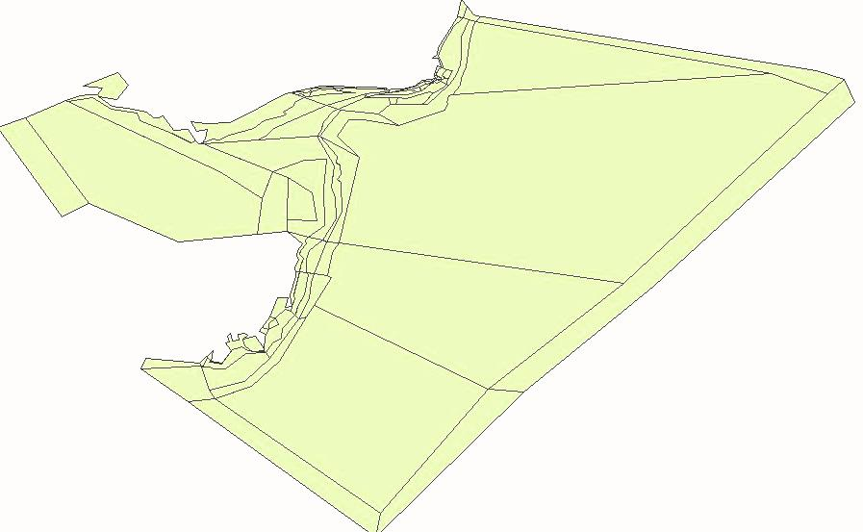
Assessing Performance at Multiple Scales
Local scale
Regional scale
Whole ecosystem scale
Notes:
We are interested in looking at how the indicators work on a range of scales.
The local scale is simply looking at the MPAs themselves and the areas immediately surrounding them. We would expect that these areas would show the most impact from the protection and also that indicators would most strongly detect a change in these area.
We would hope to still see some benefit from the MPAs at the regional scale. This is a larger area than the local scale regions, but should potentially incorporate some similar bioregions as those covered by the MPAs.
The whole ecosystem scale aims to see whether we can detect any impact of the MPAs throughout a much larger area. If, for example, the MPAs are acting as a refuge for juvenile stages of pelagic fish, then it is plausible that we may see an increase in these fish in the outer boxes in the blue circle. We are looking at whether any of our tested indicators can detect a change at this scale.

Slide 8


Indicators
Triple Bottom Line
Notes:
Determining management objectives is a huge task within itself.
Management objectives for MPAs historically have been very poorly defined, which means the performance of MPAs are difficult to measure.
All stakeholders must be incorporated into this process so that commercial and conservation values are represented.
The triple bottom line concept has been incorporated into legislation, therefore it is essential that this range of objective be monitored.
Ecologically sustainable fishing requires a combination of social, conservation and economic performance measures
All stakeholders must be consulted (Fishers, Conservationists, Recreational users)
Indicators must cover the triple bottom line too then

Slide 9
Robust indicators
Relative Biomass |  |  | Size structure (% big) & spectra
Gelatinous zooplankton |  |  | Size at maturity (weight & length)
Cephalopods |  |  | Biophysical (Chla, ºC, pH)
Planktivores
Scavengers
Demersal fish
Habitat cover |  |  | Potential
Piscivores |  |  | Diversity
Top predators |  |  | Habitat-Fisheries Overlap
Biomass ratios |  |  | CPUE
Piscivore : Planktivore |  |  | Maximum length of catch
Pelagic : Demersal
Infauna : Epifauna
Notes:
- KISS
- Scale effects when looking at structure
- Ancillary to give context and undersdtanding
- Fisheries dependent not as trustworthy/informative

Slide 10

Sampling Design
Look at alternative sampling schemes
Low continuous coverage
Intense coverage or snapshots

Slide 11
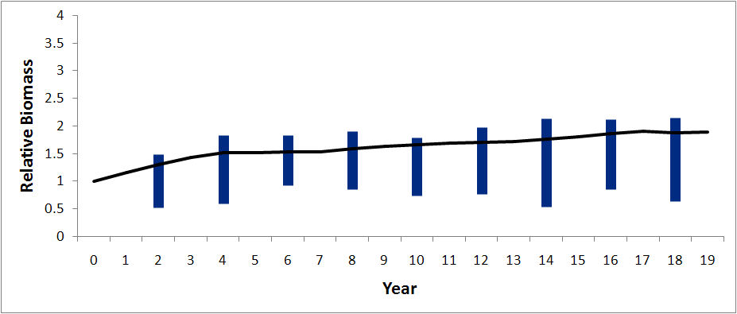
Sampling Frequency
Continuous but low coverage

Slide 12
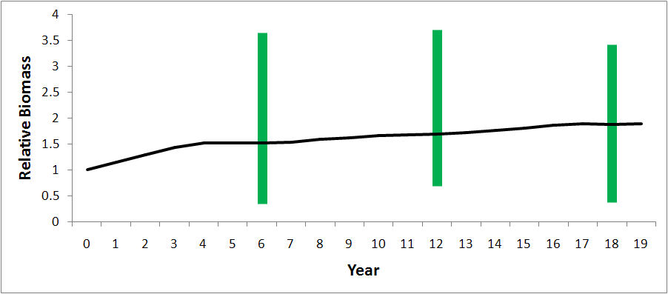
Sampling Frequency
High intensity snapshots

Slide 13
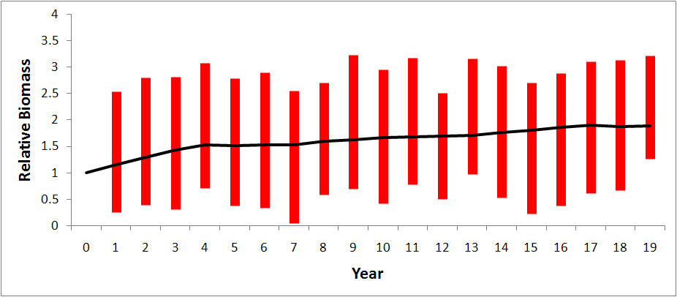
Sampling Frequency
No limits (high frequency & coverage)

Slide 14
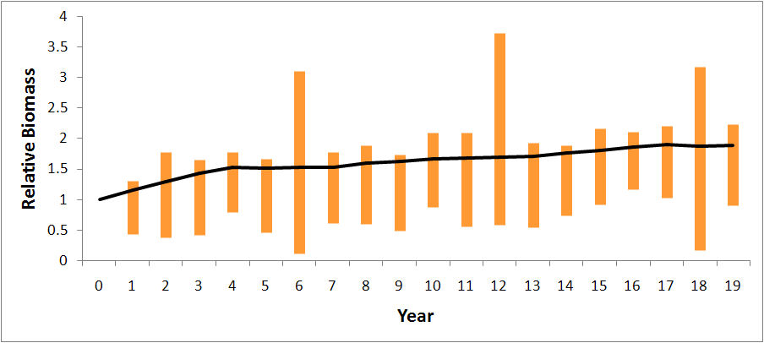
Sampling Frequency
  poorer with snapshots (intensity doesn’t help)
  stratification critical for reliable signal detection
Patchy

Slide 15
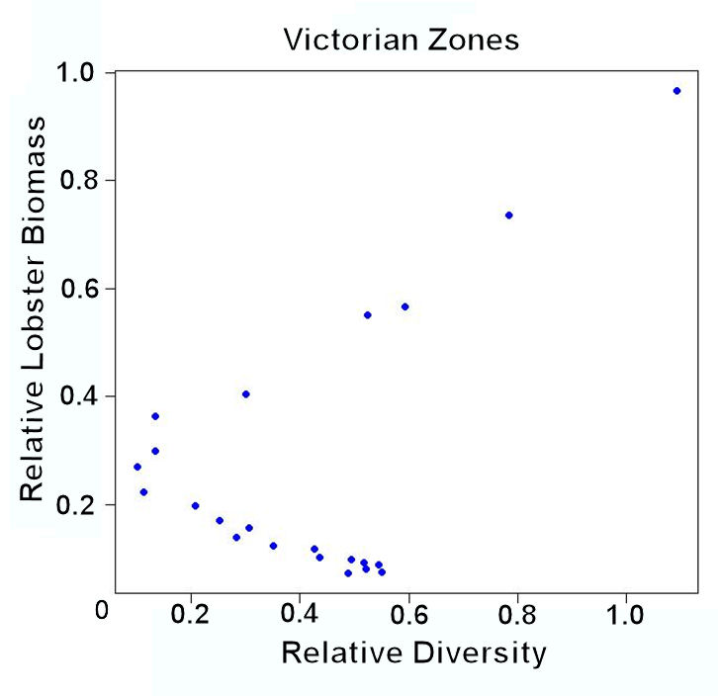
Look at reference relationships
Reference directions not universal even within an LME
    makes “simple management rules” tricky

Slide 16
Potential ecological indicators
Relative biomass (compared with ‘virgin’ system)
  either of individual groups or indicator species
  ecosystem as a whole
Biogenic habitat cover
  eg, sponges, seagrass, macroalgae
Biomass ratios / aggregate biomass estimates
  eg. Pelagic:demersal, plantkivore:piscivore, infauna: epifauna
Average trophic levels
  eg. Have we removed all top predators
Size distribution
  Abundance/biomass curves
Taxonomic diversity
Notes:
Bit of information on previous studies that have looked at these types of ecological indicators – which systems they have been found to be robust in in previous studies
Biomass ratios, eg, excessive demersal fish can be indicative of a heavily fished system. Excessive small pelagic species can indicate a reduction in predation. Conversly, a lack of small pelagics may mean there is insufficient forage for target species.
Average trophic level – may be that we have removed a large portion of large predators such as tuna, or it may be that we have removed a large portion of a mid trophic group such as sardines, or squid. Potential impacts associated with this could be a lack of fodder for higher trophic groups, or the weakening of trophic links between low and high trophic levels.
Indicator species – increases in the relative biomass of scavenger groups such as starfish or crabs may indicate notable fishing pressure in the area

Slide 17
Potential fisheries indicators
Catch and CPUE
  Total and relative magnitude
Discards
  In relation to target species
Spawning stock size of target species
Size of individuals of target species
Total value $
Social perception (based on surveys of public concern)
Notes:
Social and economic related indicators

Slide 18
Assessing Performance
Actual signal vs indicator signal
  correlation plot
  signal strength at different scales & scenarios
Large MPA
Scenario
Small MPA
Indicator
Attribute
Scenario
Score
Spatial scale
Notes:
Look for fidelity of signal strength
Either by correlations across signal strength under different scenarios, specifications and background conditions
Plots of signal strength at different spatial scales under different scenarios, specifications and background conditions

Slide 19
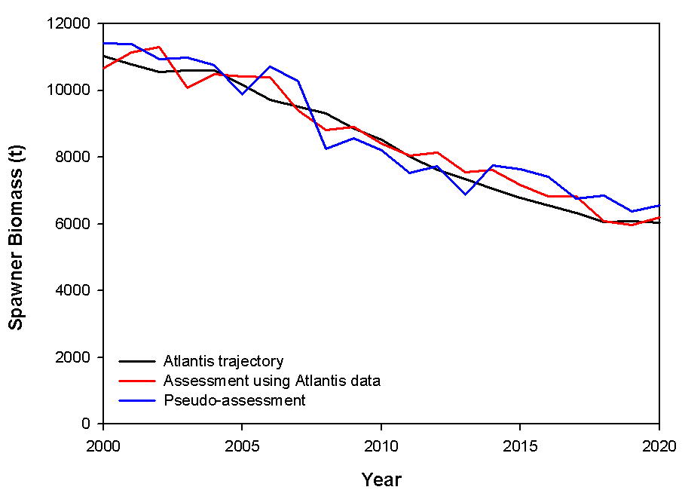
Assessment
Simulate implementation of actual assessment models (catch curves, surplus production, VPA, integrated)
  integrated assessments (e.g. Punt method)
Check robustness of system to assessment pitfalls.
If not focus of work can ‘mimic’ instead
  computational time saver
Notes:
Observation model includes fisheries records + option for independent surveys
Replicates data patchiness/error/design problems
Assessment models = range of ones typically used from simple trend analysis to highly sophisticated (complicated) assessment methods
- Also includes the calculation of ecological indicators (if want to think about what real EBFM might entail)

Slide 20
Ecosystem “Assessment” Models
Link to other models (e.g. Stock Assessments)
Simpler means of assessing system rather than building “world variant”
  Biomass Size Spectra (pool by size not taxonomy) with secondary functional grouping has potential
  Integrated measures (like what’s used in stream quality assessments) may be useful
  Loop analysis
  Bayesian Belief Networks may be useful for integrating indicators with apparently conflicting signals

Slide 21
Exploring the File
  Open VMPA_setas_assess.prm…

Slide 22

Thank you
CSIRO Marine & Atmospheric Research
Dr Beth Fulton
CEO Fellow
Phone: +61 3 6232 5018
Email: beth.fulton@csiro.au
Web: www.csiro.au/wfo
www.cmar.csiro.au
Contact Us
Phone: 1300 363 400 or +61 3 9545 2176
Email: enquiries@csiro.au Web: www.csiro.au

